Slide 1
Substance Abuse Treatment
Ken Martz, Psy.D. CAS
Special Assistant to the Secretary
Pennsylvania Department of Drug and Alcohol Programs

Slide 2
Fast Facts
Every dollar spent in AOD treatment saves 7$
If medical expenses are included that rises to 11$
Effective treatment works.
Clinically appropriate levels of care work.
… But what is that?
Why care about drug and alcohol treatment?
  1 in 4 people has substance abuse in their families
  1 in 4 people with addiction will die as a result
  Most addicted individuals never commit crimes

Slide 3

Cost/Benefit
In 2007, the cost of illicit drug use alone (Does not include alcohol abuse) totaled more than $193 billion. Direct and indirect costs attributable to illicit drug use are estimated in three principal areas: crime, health, and productivity.
Crime: includes three components: criminal justice system costs ($56,373,254), crime victim costs ($1,455,555), and other crime costs ($3,547,885). These subtotal $61,376,694.
Health: includes five components: specialty treatment costs ($3,723,338), hospital and emergency department costs for non-homicide cases ($5,684,248), hospital and emergency department costs for homicide cases ($12,938), insurance administration costs ($544), and other health costs ($1,995,164). These subtotal $11,416,232.
Productivity: includes seven components: labor participation costs ($49,237,777), specialty treatment costs for services provided at the state level ($2,828,207), specialty treatment costs for services provided at the federal level ($44,830), hospitalization costs ($287,260), incarceration costs ($48,121,949), premature mortality costs (non-homicide: $16,005,008), and premature mortality costs (homicide: $3,778,973). These subtotal $120,304,004.
  Taken together, these costs total $193,096,930, with the majority share attributable to lost productivity. The findings are consistent with prior work that has been done in this area using a generally comparable methodology (Harwood et al., 1984, 1998; ONDCP, 2001, 2004).
  This report by ONDCP does not include alcohol related costs, which would add to these numbers
For Pennsylvania this cost for illicit drug use would be $8,289,740,227

Slide 4
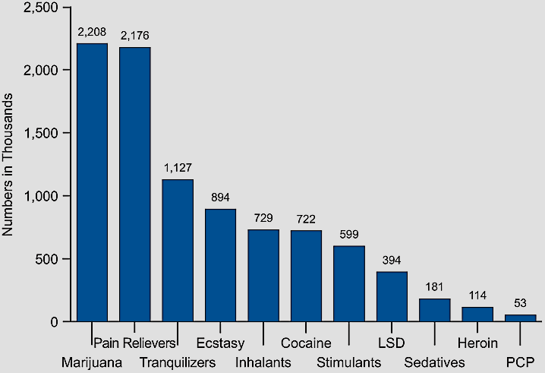
Overview of Substance and Drug Use
Past-Year Initiates for Specific Illicit Drugs Among Persons Age 12 or Older, 2008
Source: Substance Abuse and Mental Health Services Administration. (2009). Results From the 2008 National Survey on Drug Use and Health: National Findings Rockville, Maryland.

Slide 5
Heroin Related Overdose Deaths in Pennsylvania
Based on Pennsylvania Corners Association (PCA) reports in 43 counties, heroin and heroin related deaths have been on the rise for the past 5 years (PCA, 2013)
Between 2009 and 2013 there 2,929 heroin related overdose deaths identified by county coroners. Of these, 490 (17%) were heroin only, while 2,439 (83%) involved multiple drugs.
Other drugs commonly found along with heroin overdose include
  Other opiates: Methadone, Oxycodone, Fentanyl, Morphine, Codeine, Tramadol
  Other Illegal drugs: Marijuana, cocaine
  Other sedating drugs: Alcohol, benzodiazapines
  Antidepressant medications: Prozac, Celexa, Remeron, Trazadone, Zoloft

Slide 6
FDA Warning Labels
In September 2013 the FDA updated the warning labels on long acting opioid products.
  The new labeling adds: "Because of the risks of addiction, abuse and misuse with opioids, even at recommended doses, and because of the greater risks of overdose and death with extended-release opioid formulations, reserve [Trade name] for use in patients for whom alternative treatment options (e.g., non-opioid analgesics or immediate-release opioids) are ineffective, not tolerated, or would be otherwise inadequate to provide sufficient management of pain."

Slide 7
Progression of a Disease and Recovery
Prevention
(Relapse)Prevention
No addiction
Late Recovery
Outpatient Treatment
Give to others
Optimism
Regain job
Face problems
Honesty
More relaxed
Relationships improve
Begin to develop trust
Resolve legal issues
Self respect returning
Connect with sponsor/
positive peer group
Self examination
Medical stabilization
Thinking begins to clear
Desire for help
No drinking
Social drinking
Drinking feels good
Drink to relax
Drink to escape
Withdrawal from friends
First DUI
Conflict in relationships
Missed time from work
Regular drinking
Amount of drinking increases
Drink to stop feeling bad
Disciplinary action at work Association with negative peer group
Antisocial beliefs justify behaviors
Increasing health complications
Relationship isolation/ alienation
Early Addiction
Middle Recovery
Intensive Treatment
Middle Addiction
Early Recovery
Late Addiction
“Rock Bottom”, Arrests
Divorce, Loss of Job
Depression,
Hopelessness,
Suicide, Death
Notes:
Motivation levels as related to level of care placements.

Slide 8
Biology
Example of 2 Brain pathways
Urge to Use
Decision to Use
Decision not to Drink
Get Money (may be illegally)
Engage in Abstinence Behavior, eg call sponsor
Recovery Behavior, eg go to work, be honest, manage family etc
Go to dealer
Late Stage Recovery Behavior
Use, Use, Use
Drug wears off, crash

Slide 9
Biology
Example of 2 Brain pathways
Urge to Use
Decision to use
Decision not to use
Get Money
Engage in Abstinence Behavior, eg. call sponsor
Recovery Behavior eg. go to work, be honest, manage family etc
Go to dealer
Late Stage Recovery Behavior
Use
Drug wears off, crash
Prison
Notes:
Some say need medication
Know of a number heroin addicts with long term drug free recovery.
In this context the role of medication is as a support to reduce urges. But, like prison it does nothing to train in recovery behaviors.
This is also true of the need to practice prosocial behaviors and thinking pattens.
Remember most addicts never end up in prison, eg DUI so inmates are the most severe group.

Slide 10

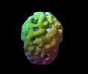
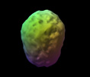
Recovery Heals the Brain
Normal healthy view.
Top down surface view.
Full, symmetrical activity
During substance abuse One year drug and alcohol free
Notice the overall holes and shriveled appearance during abuse
and marked improvement with abstinence.

Slide 11
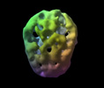
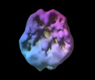

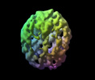
Which Brain do You Want?
Normal healthy view.
Top down surface view.
Full, symmetrical activity
Effects of other substances:
Long term alcohol abuse | 57 y/o 30 years marijuana abuse (underside view) | 39 y/o – 25 years frequent heroin use | 40 y/o, 7 years on methadone. Heroin 10 years prior.

Slide 12
Why does one become addicted?
Causes | Solutions
Biology Genes, Biochemistry, Brains, Autopilot Learning | Medication, Meditation Exercise, Diet, Sleep, Stress Management Decisional Actions
Relationships with Others Peer Pressure, Family, “Enabling”, Isolation, Lies | Limit Setting, Relationship Building, Honesty, Clear Communication Family/Couples Therapy Positive Peer Pressure
Relationship with Self Shame, Guilt, Negative Beliefs, “Hate Self” | Forgive Self, Gratitude Practice Engage in Healthy Behaviors Today Healthy Coping Skills Training
Relationship with Higher Power Lack of Connection with Personal Values, Anger/Shame with God | Define Values, Live by Personal Values Pray, Meditate, Other Spiritual Practice

Slide 13
What Works?
What Works? Key Issues:
Therapeutic dose issues
  Level of care
  Length of stay
  Continuum
Quality issues
  Evidence based practices
  Behavioral practice
  Cognitive restructuring
  Emotion/coping
  Trauma
  Monitoring/ case management/Advocacy
Comprehensive care elements
  Recovery supports/12-step
  Employment
  Housing

Slide 14
PCPC
Importance of Level of Care
  Under treating can lead to treatment resistance or increased progression of the disease
    What happens if you take a half dose of antibiotic?
    What happens if you take a half dose of insulin?
    What happens if you take a half dose of treatment?
  Answer:
    It doesn’t work
    Individuals get sicker
    Individuals and providers “give up” believing that there is no hope

Slide 15
What the Treatment Research Indicates
Notes:
_______________________________________________________
_______________________________________________________
_______________________________________________________
_______________________________________________________
_______________________________________________________
_______________________________________________________
_______________________________________________________
_______________________________________________________

Slide 16
Treatment Benefits
Ettner, et al., 2006

Slide 17
Villanova Study (1995)
Evaluated the implementation of Act 152
This study found:
  Average LOS for 3C was 90 days (1995)
  The study found that those completing treatment had:
    Lower rates of recidivism
    Lower utilization of medical services
    More likely to obtain employment
    More likely to have higher paying employment
      This proper care is the way to move high cost utilizers off of Medicaid and into private insurance
      Establishing ongoing recovery is the best cost saver
  Better outcomes were found with:
    Longer lengths of stay
    More complete continuum of care
  Compare with current Average LOS for 3C is 47 days (2011)

Slide 18
Length of Stay
Studies consistently find length of stay as the primary predictor of outcomes, along with intensity of treatment and continuum of care.
Days in Treatment
Source: Zhang (2002). Does retention matter?
Treatment duration and improvement in drug use.
(4,005 clients)
Source: Pennsylvania Department of Corrections (1997) Pennsylvania FIR Evaluation
Source: Greenfield et al, (2004). Effectiveness of Long Term Residential Treatment for Women: Findings from 3 National Studies
Notes:
_______________________________________________________
_______________________________________________________
_______________________________________________________
_______________________________________________________
_______________________________________________________
_______________________________________________________
_______________________________________________________
_______________________________________________________

Slide 19
Length Of Stay
Studies consistently find length of stay as the primary predictor of outcomes, along with intensity of treatment and continuum of care.
Improvements in criminal recidivism and relapse rates are correlated to length of treatment, with highest rates of improvement among those with 9 months of treatment, and reduced effectiveness for treatment of less than 90 days (NIDA, 2002)
Highest improvements were found in long term treatment with least improvement found in methadone maintenance (Friedmann et al, 2004)
Lengths of stay are the number one predictor of outcomes for treatment (President’s Commission on Model State Drug Laws, 1993)
Average length of stay for Medicaid clients was 90 days (Villanova Study, 1995). Best outcomes were found for longer lengths of stay and more complete continuum of care, measured as lack of criminal recidivism, abstinence, employment and higher paying jobs. No benefit was found for treatment less than 90 days. Currently, average length of stay in treatment for long term residential is 47 days (DPW, 2011)
Length of stay has a direct linear relationship with improved outcomes (Toumbourou, 1998)
Found residential treatment of 90 days and continuum of care to yield 78% abstinence rates for 5 years. (DuPont, et al. 2009)

Slide 20
Pennsylvania Success Story
Restrictive Intermediate Punishment Program (RIP, 2014)
Current Alternative Sentencing Option for Level 3 & 4 Offenders Places Offenders in Treatment Based on Need
  79% Overall Successful Program Completion Rate
    93% Successful Outcomes for DUI Offenders
    66% Successful Outcomes for Drug Offenders
  13.7% Recidivism Rate for Successful Completions at 1 year
    DOC 1 Year Recidivism = 25.9%
    At 18 months Program Recidivism has flattened; DOC continues to trend up

Slide 21
Treatment Works: But what is treatment?
Treat addresses a wide range of clinical issues that cause and exacerbate risks of substance abuse.
  These include the needs for habilitation and rehabilitation, including vocational supports, addressing trauma, learning coping skills, learning relapse prevention skills, improving relationships etc.
This is not to be confused with supporting services such as detoxification, medications, peer supports, 12-step programs, housing and other similar approaches which complement the core treatment program.
Notes:
_______________________________________________________
_______________________________________________________
_______________________________________________________
_______________________________________________________
_______________________________________________________
_______________________________________________________
_______________________________________________________
_______________________________________________________

Slide 22
What is a Therapeutic Community?
What were they doing that worked?

Slide 23
What is a Therapeutic Community?
What it is:
  High accountability
  Behavioral practice and feedback
  Correction of criminogenic beliefs and thinking patterns
  Tools in practicing effective management of negative emotions
Although the TC has many elements, a defining principle is the use of Community as Method

Slide 24
Treatment Goals
Addiction
Abstinence
Recovery
Chemical addiction | Withdrawal | “Addiction” to recovery behaviors
Dysfunctional relationships | Tension/ distrust/ judgment in relationships | Trust, partnership, respect in relationships
Negative self image | Lack of confidence/ doubts | Self respect
Lack of values/spiritual connection | Questioning of values | Knowing personal values and following them
Motivation to use/drink | Motivation to stop drinking/avoid pain | Motivation to seek pleasure/ health

Slide 25
Treatment Goals
Addiction
Abstinence
Recovery
Mental health issues | Awareness of mental health as triggers | Management/ remission of mental health issues
Depression | Boredom, blunted emotion | Happiness, range of emotion
Avoidance /numbing of feelings | Aware of uncomfortable feelings | Able to tolerate unpleasant feelings as they arise
Lack of range of coping skills | Novice at identifying coping strategies | Competent at a range of coping strategies
Unresolved trauma/grief | Aware of losses | Able to “let go” of past
Personality disorder(s) | Aware of personal issues | Able to reduce negative impact of personality style
Unmedicated (bipolar, ADHD etc) | Finding proper medication combination | Stable on effective medication

Slide 26
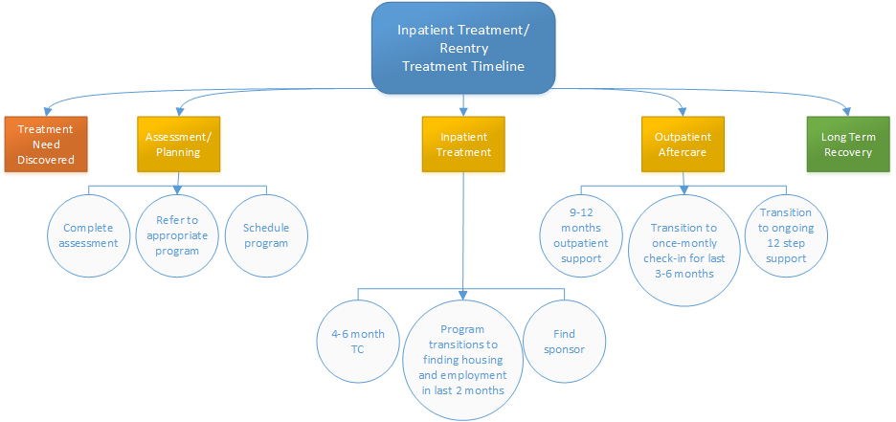
Comprehensive Continuum of Care

Slide 27
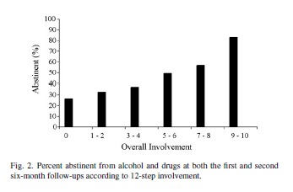
Peer Supports
Increasing attendance at 12-step meetings following treatment are associated with increased rates of abstinence (Timko & DeBenedetti, 2007).
  This includes a range of activities such as attendance, getting a sponsor, being a sponsor, reading at meetings, calling a 12-step member for help etc.
Notes:
_______________________________________________________
_______________________________________________________
_______________________________________________________
_______________________________________________________
_______________________________________________________
_______________________________________________________
_______________________________________________________
_______________________________________________________

Slide 28
Recovery Lessons Learned
Faces and Voices of Recovery Survey of 3,200 individuals with an average of 10 years in recovery.
Personal Descriptions:
  The majority (75%) selected “in recovery”;
  14% chose “recovered,”
  8% “used to have a problem with substances and no longer do,”
  3% chose “medication-assisted recovery.”
Paths to Recovery:
  71% professional addiction treatment
  18% had taken prescribed medications (e.g., buprenorphine or methadone).
  95% had attended 12-step fellowship meetings (e.g., Alcoholics Anonymous),
  22% had participated in non-12-step recovery support groups (e.g., LifeRing, Secular Organizations for Sobriety (S.O.S.).

Slide 29
The Solution
Prevention
  Healthy Pennsylvania Permanent Drop Boxes for medication disposal
Treatment
  Starting in January, Healthy Pennsylvania will offer coverage to a wider range of Pennsylvanians so that those with substance abuse can access care
Innovative Thinking
  Governor Wolf has proposed an additional $5 million to address the opioid epidemic in the state budget
Notes:
_______________________________________________________
_______________________________________________________
_______________________________________________________
_______________________________________________________
_______________________________________________________
_______________________________________________________
_______________________________________________________
_______________________________________________________

Slide 30
The Solution (cont.)
Continue /Expand current initiatives
  Restrictive Intermediate Punishment
  Enforcement of DUI laws
  Enforce Existing laws (Act 106, Act 152, ACA, MHPAEA)
  Medicaid Pilot Project
    Prevents unnecessary spending from lack of agency coordination
  Prescriber Practices Workgroup
    Emergency Department Pain Treatment Guidelines
    Opioid to Treat Non-Cancer Pain
    Prescribing Guidelines for Dentists
  Prescription Drug Monitoring Program
  Naloxone
  Good Samaritan
Notes:
_______________________________________________________
_______________________________________________________
_______________________________________________________
_______________________________________________________
_______________________________________________________
_______________________________________________________
_______________________________________________________
_______________________________________________________

Slide 31
Recommendations
Why Treatment Fails | Why Treatment Works
Length of Stay (Less than 90 days) | Length of Stay (More than 90 days)
Undertreating (Giving OP instead of TC) | Appropriate Level of Care
Fragmented care (Detox only, 12-step only) | Full Continuum of Care
Weak Enforcement of Insurance Law | Enforcement of State and Federal Laws
Medicating all Pain | Appropriate Prescribing
Stigma (Seeing individuals as “bad”) | Humanizing (Treating those with disease)
Locking up Drug Users | Treating those with Substance Use Disorder
Thinking There is a Silver Bullet | Clinical Integrity
What Works: Clinical Integrity
Notes:
_______________________________________________________
_______________________________________________________
_______________________________________________________
_______________________________________________________
_______________________________________________________
_______________________________________________________
_______________________________________________________
_______________________________________________________

Slide 32
What Can I Do? 10 Simple Steps
Are my programs trained in cross-system needs (criminal justice, child welfare, medical etc)?
Are my system partner programs trained in drug and alcohol treatment?
Are we using adequate lengths of stay or terminating based on funding?
Are we using a continuum of care?
Are we educating on proper prescribing practices?
Does our county have medication take back boxes?
Are we expanding the use of Naloxone to save overdose victims?
Are we facilitating access to funding for needed services such as implementing the jail Medicaid project?
Are we supporting our community efforts for prevention, to reach long term improvement.
Are we doing SOMETHING? Pick one and keep moving forward.
Notes:
The trainer will review the requirements of Act 106.. This information is included in the training to provide participants with more knowledge that could be used in advocating for the appropriate LOC for the individual they are helping. Act 106 overview can be found in the manual…Appendix 9, page 142
Act 106 of 1989 requires all commercial group health plans, HMOs, and the children’s Health Insurance Program to provide comprehensive treatment for alcohol and other drug addictions.
Minimum benefits:
1. Up to 7 days detox per admission, 4 admissions per lifetime (hospital or non-hospital residential detox
2. 30 days rehabilitation per year, 90 days per lifetime (non-hospital residential)
3. 30 sessions of outpatient/partial hospitalization per year, 120 sessions per lifetime
4. Family counseling and intervention services
5. Additional treatment beyond the above, 30 additional outpatient/partial hospitalization sessions are provided which can be utilized on a two-to-one basis to provide 15 additional non-hospital, residential treatment days.
Per the PA Insurance department (PA Bulletin Notice 2003-06)…the only lawful prerequisite before an insured obtains non-hospital residential and outpatient coverage for treatment is a certification and referral from a licensed physician or licensed psychologist. The same prerequisite applies for inpatient detoxification coverage. The certification and referral in all instances controls both the nature and duration of treatment. The certification and referral in all instances controls both the nature and duration of treatment. The location of treatment is subject to the insuring entity's requirements regarding the use of participating providers.
32

Slide 33
Contact Information
Ken Martz, Psy.D. CAS
Special Assistant to the Secretary
Pennsylvania Department of Drug and Alcohol Programs
02 Kline Village
Harrisburg, PA 17104
KeMartz@pa.gov
(717)783-8200

